Slide 1
Computer Graphics 7th Recitation “Transformations”
Anna Shtengel
Based on slides by Michael Litvin
26.04.2015

Slide 2
Transformations
Practice practice…

Slide 3
Let’s play!
goo.gl/0xFKa

Slide 4
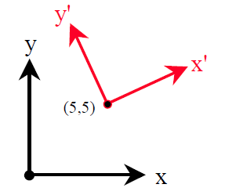

1.
Given is the point $p={\left(10,5\right)}^{T}$, represented in the $\left(x,y\right)$ coordinate system.
Calculate the representation of the above point in the $\left(x^{′},y^{′}\right)$ coordinate system, whose origin is at $q={\left(5,5\right)}^{T}$ and the $x^{′}$ axis points towards the direction ${\left(3,4\right)}^{T}$.
Notes:
M=
0.6000 -0.8000 5.0000
0.8000 0.6000 5.0000
0 0 1.0000
M^-1=
0.6000 0.8000 -7.0000
-0.8000 0.6000 1.0000
0 0 1.0000
p‘=M^-1*p
[-6/5;8/5;1]=M^-1*[3;5;1]
[-17/5;6/5;1]=M^-1*[2;3;1]
[-16/5;13/5;1]=M^-1*[1;4;1]

Slide 5
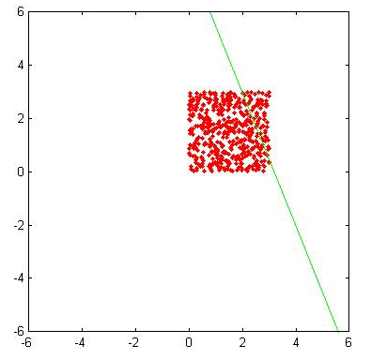
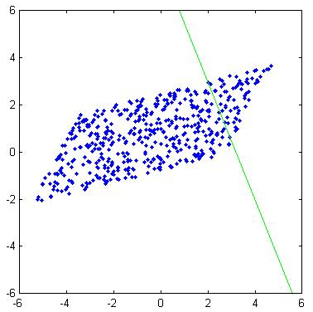

2.
Calculate the transformation matrix that scales objects by $3$ in the direction parallel to the vector $v=\left(3,4\right)$, such that the point $Q=\left(2,3\right)$ is a stationary point (נקודת שבת) of this scaling.

Slide 6
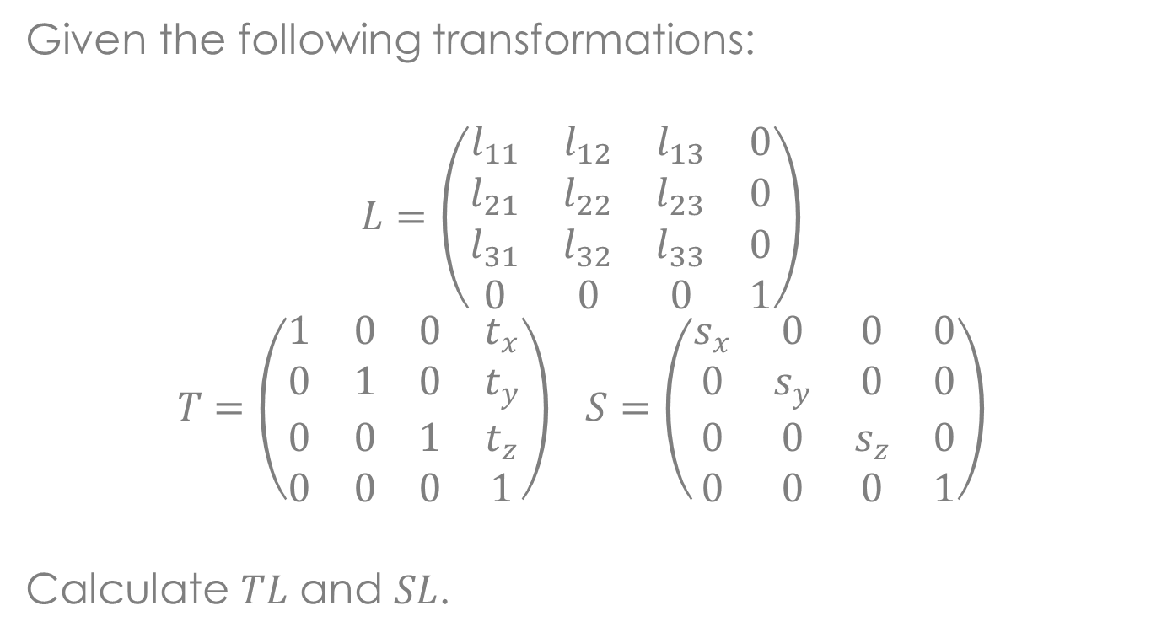
3.
Given the following transformations:
$$L=\left(\begin{matrix}l_{11} & l_{12} & l_{13} & 0 \\ l_{21} & l_{22} & l_{23} & 0 \\ l_{31} & l_{32} & l_{33} & 0 \\ 0 & 0 & 0 & 1\end{matrix}\right)$$
$$T=\left(\begin{matrix}1 & 0 & 0 & t_{x} \\ 0 & 1 & 0 & t_{y} \\ 0 & 0 & 1 & t_{z} \\ 0 & 0 & 0 & 1\end{matrix}\right) S=\left(\begin{matrix}s_{x} & 0 & 0 & 0 \\ 0 & s_{y} & 0 & 0 \\ 0 & 0 & s_{z} & 0 \\ 0 & 0 & 0 & 1\end{matrix}\right)$$
Calculate $TL$ and $SL$.

Slide 7
4.
An orthonormal matrix is a matrix whose columns are orthogonal to each other, and their magnitudes are 1.
Write this definition in mathematical form.
How do you invert a square orthonormal matrix?
Which linear transformations have orthonormal matrices?

Slide 8
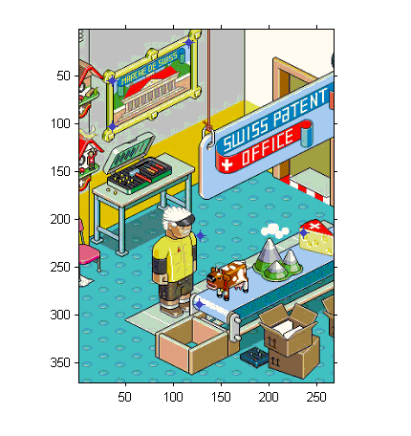
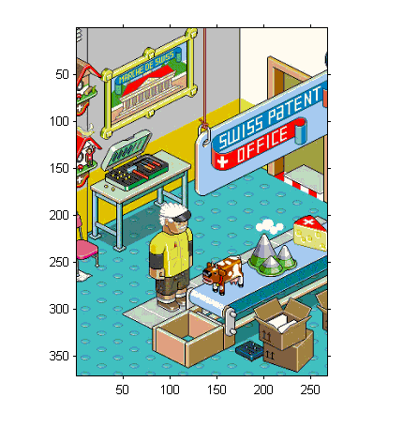
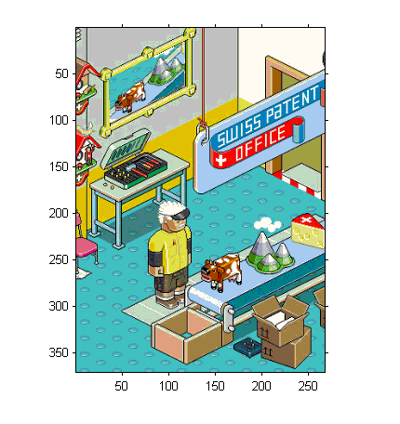
5.
Notes:
http://media.smashingmagazine.com/cdn_smash/images/pixel-art/pixel-art-11.png

Slide 9

5.
In a 2d image calculate the transformation that maps one parallelogram (מַקְבִּילִית) $P_{0}P_{1}P_{2}$ to another $Q_{0}Q_{1}Q_{2}$.
Q₀
Q₁
Q₂
P₀
P₁
P₂

Slide 10

6.
A camera is positioned at ${\left(5,5,5\right)}^{T}$ looking in the ${\left(−1,−1,−1\right)}^{T}$ direction. The camera’s projection plane distance is 1 (its normal is also ${\left(−1,−1,−1\right)}^{T}$).
Where will the point ${\left(1,1,0\right)}^{T}$ be projected?

Slide 11
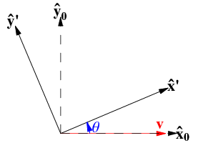

7.
Calculate the 2d transformation matrix that rotates a vector $α$ degrees counter-clockwise around the center of the axes.
Find its inverse.

